Slide 1
Data Structure and Algorithms Lec-04
Course Teacher: Prof. Dr. Mostofa Kamal Nasir [MKN1]
E-mail: kamal.mostofa@gmail.com
mostafa.nasir@northsouth.edu

Slide 2
Algorithm
An Algorithm is any well-defined computational procedure that takes some values or set of values as input and produces some values or set of values as output.
An Algorithm is a well defined list of steps to solve a particular problem.

Slide 3
NOTION OF ALGORITHM
problem
algorithm
“computer”
input
output
Algorithmic solution

Slide 4
A short list of categories
Algorithm types we will consider include:
Simple recursive algorithms
Backtracking algorithms
Divide and conquer algorithms
Dynamic programming algorithms
Greedy algorithms
Branch and bound algorithms
Brute force algorithms
Randomized algorithms

Slide 5
SOME WELL-KNOWN COMPUTATIONAL PROBLEMS
Sorting
Searching
Shortest paths in a graph
Minimum spanning tree
Primality testing
Traveling salesman problem
Knapsack problem
Chess
Towers of Hanoi
Program termination

Slide 6
Algorithms
Properties of a good Algorithm:
• Input from a specified set,
• Output from a specified set (solution),
• Effectiveness of each calculation step and
• Finiteness of the number of calculation steps,
• Correctness of output for every possible input

Slide 7
Suppose computers were infinitely fast and computer memory are free.
Is there any reason to study algorithm ?

Slide 8
Yes
– Demonstrate that solution, methods and so with correct answer.
If computers were infinitely fast, any correct method for solving a problem would do.
You would probably want your implementation to be within the bounds of good software engineering practice.

Slide 9
In reality
Computers may be fast, but they are not infinitely fast and Memory may be cheap but it is not free.
Computing time is therefore a bounded resource and so is the space in memory

Slide 10
Complexity
Algorithmic complexity is concerned about how fast or slow particular algorithm performs.
We define complexity as a numerical function T(n) - time versus the input size n.

Slide 11
Complexity
In general, we are not so much interested in the time and space complexity for small inputs.
For example, while the difference in time complexity between linear and binary search is meaningless for a sequence with n = 10, it is gigantic for n=2³⁰.

Slide 12
Complexity
For example, let us assume two algorithms A and B that solve the same class of problems P.
The time complexity of A is 5,000 n, the one for
B is [1.1^{n}] for an input with n elements.
For n = 10, A requires 50,000 steps, but B only
3, so B seems to be superior to A.
For n = 1000, however, A requires 5,000,000
steps, while B requires 2.5*10⁴¹ steps.

Slide 13
Complexity
Comparison: Time complexity of algorithms A &B.
Input Size | Algorithm A | Algorithm B
n | 5,000n | [1.1^{n}]
10 | 50,000 | 3
100 | 500,000 | 13,781
1,000 | 5,000,000 | 2.5*10⁴¹
1,000,000 | 5.10⁹ | 4.8*10⁴¹

Slide 14
Complexity
This means that algorithm B cannot be used for large inputs, while algorithm A is still feasible.
So what is important is the growth of the complexity functions.
The growth of time and space complexity with increasing input size n is a suitable measure for the comparison of algorithms.

Slide 15
Growth Function
The order of growth/rate of growth of the running time of an algorithm gives a simple characterization of the algorithm efficiency and allow us to compare the relative performance of alternative algorithm

Slide 16
Asymptotic Efficiency Algorithm
When the input size is large enough so that the rate of growth/order of growth of the running time is relevant.
Usually, an algorithm that is asymptotically more efficient will be the best choice for all but not very small inputs.

Slide 17
Asymptotic Notation
The notations we use to describe the asymptotic running time of an algorithm are defined in terms of functions whose domains are the set of natural numbers
N = {0, 1,2,…. }

Slide 18
Asymptotic Notation
Asymptotic notations are convenient for describing the worst-case running time function T(n), which is defined only on integer input size.
Let n be a non-negative integer representing the size of the input to an algorithm

Slide 19
Asymptotic Notation
Let f(n) and g(n) be two positive functions, representing the number of basic calculations (operations, instructions) that an algorithm takes (or the number of memory words an algorithm needs).

Slide 20
Time for an algorithm to run T(n)
A function of input. However, we will attempt to characterize this by the size of the input. We will try and estimate the WORST CASE, and sometimes the BEST CASE, and very rarely the AVERAGE CASE.
Worst Case: is the maximum run time
Best Case: minimum run time
Average Case: It is the average run time.
We can measure this three using different function.

Slide 21
Binary search. Given value and sorted array a[], find index i such that a[i] = value, or report that no such index exists.
Invariant. Algorithm maintains a[lo] ≤ value ≤ a[hi].
Ex. Binary search for 33.
6
13
14
25
33
43
51
53
64
72
84
93
95
96
97
0
1
2
3
4
5
6
7
8
9
10
11
12
13
14
lo
hi

Slide 22
Asymptotic Notation
O – Big O
Ω - Big Omega
Θ - Big Theta

Slide 23
O-Notation
For a given function g(n)
O (g(n)) = {f(n) : there exist positive constants c and n₀ such that 0 ≤ f(n) ≤ c g(n) for all n ≥n₀ }
Intuitively: Set of all functions whose rate of
growth is the same as or lower than that of c.g(n)

Slide 24
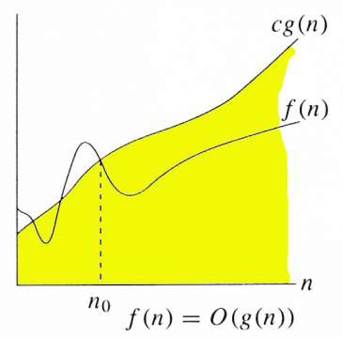
O-Notation
g(n) is an asymptotic upper bound for f(n).
f(n) = Θ(g(n)) ⇒ f(n) = O (g(n)).
Θ(g(n)) ⊂ O (g(n)).

Slide 25
Example
O (g(n)) = {f(n) : there exist positive constants c and n₀ such that
0 ≤ f(n) ≤ c g(n) for all n ≥ n₀ }
Any linear function an + b is in O (n²).
C = a + |b| and n₀ = 1

Slide 26
Ω- Notation
For a given function g(n)
Ω(g(n)) = {f(n) : there exist positive constants c and n₀ such that 0 ≤ c g(n) ≤ f(n) for all n ≥ n0}
Intuitively: Set of all functions whose rate of growth is the same as or higher than that of g(n).

Slide 27
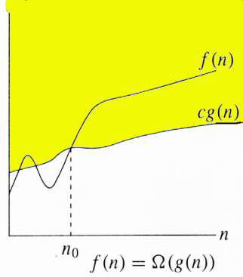
Ω- Notation
g(n) is an asymptotic lower bound for f(n).
f(n) = Θ(g(n)) ⇒ f(n) = Ω(g(n)).
Θ(g(n)) ⊂ Ω(g(n)).

Slide 28
Θ - Notation
For a given function g(n), we denote by Θ(g(n)) the set of functions
Θ(g(n)) = {f(n) : there exist positive constants c₁, c₂, and n₀ such that 0 ≤ c₁ g(n) ≤ f(n)≤c₂ g(n)
for all n ≥ n₀
f(n) ∈ Θ (g(n))
f(n) = Θ (g(n))

Slide 29
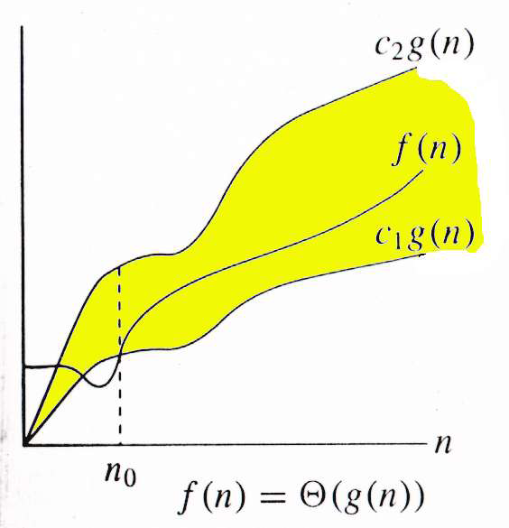
Θ - Notation
g(n) is an
asymptotically tight
bound for f(n).
f(n) and g(n) are nonnegative, for large n.

Slide 30
Relations Between Θ, O, Ω

Slide 31
Relations Between Θ, O, Ω
For any two function f(n) and g(n),
we have f(n) = Θ(g(n)) if and only
if f(n) = O(g(n)) and f(n) =Ω(g(n))
That is
Θ(g(n)) = O(g(n)) ∩ Ω (g(n))

Slide 32
The Growth of Functions
Popular functions g(n) are
nlogn, 1, 2^{n}, n², n!, n, n³,log n.
Listed from slowest to fastest growth:
• 1
• log n
• n
• n log n
• n²
• n³
• 2^{n}
• n!

Slide 33
Comparing Growth Rates
n²
n log₂ n
2^{n}
n
T(n)
log₂ n
Problem Size

Slide 34
Example: Find sum of array elements
Algorithm arraySum (A, n) Input array A of n integers Output Sum of elements of A sum ← 0 for i ← 0 to n − 1 do sum ← sum + A [i] return sum | # operations 1 n+1 n 1
Input size: n (number of array elements)
Total number of steps: 2n + 3

Slide 35
Example: Find max element of an array
Algorithm arrayMax(A, n) Input array A of n integers Output maximum element of A currentMax ←A[0] for i ← 1 to n – 1 do if A [i] > currentMax then currentMax←A [i] return currentMax | # operations 1 n n -1 n -1 1
Input size: n (number of array elements)
Total number of steps: 3n

Slide 36
Thank You

